Slide 1
SECURE DATA HIDING IN IMAGES USING STEGANOGRAHY
CAPSTONE PROJECT
Presented By: VIVEK VIJAYAKUMAR NAIR
Student Name :VIVEK VIJAYAKUMAR NAIR
College Name & Department :PILLAI COLLEGE OF ENGINEERING PANVEL COMPUTER ENGINEERING

Slide 2
OUTLINE
Problem Statement
Technology used
Wow factor
End users
Result
Conclusion
Git-hub Link
Future scope

Slide 3
Problem Statement
In today's digital world, secure communication is a major concern. Traditional encryption methods can be detected easily, making secret data transmission vulnerable to interception. Steganography offers a solution by hiding confidential information within images, making it virtually undetectable. This project provides a simple and effective way to conceal and retrieve messages from images while ensuring password protection for added security.

Slide 4
Technology used
This project leverages several powerful technologies to achieve seamless encryption and decryption:
Python – Core language for implementation.
Tkinter – Provides an interactive and user-friendly GUI for easy use.
OpenCV – Used for handling image processing operations.
NumPy – Helps with matrix operations to manipulate image pixels efficiently.
Pillow (PIL) – Facilitates image handling and supports various formats.

Slide 5
Wow factors
This tool stands out due to several innovative features: Password-protected encryption – Ensures only authorized users can access the hidden message. Stealth communication – Messages remain hidden inside images, making them undetectable to the human eye. Automatic encoded image saving & preview – Saves the modified image directly to the desktop and opens it automatically. User-friendly GUI – A simple and intuitive interface allows both encryption and decryption with just a few clicks. Lightweight & Fast – Efficient algorithms ensure that image processing is done quickly without high computational demands.

Slide 6
End users
This project has practical applications for various users: 👤 Journalists & Activists – Protect sensitive communications and avoid censorship. 👨‍💻 Cybersecurity Professionals – Enhance data protection strategies and test steganography security. 🔍 Forensics Experts – Recover hidden data in images for investigation purposes. 📧 General Users – Anyone who wants a private and secure way to send secret messages.

Slide 7

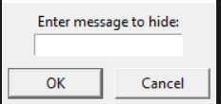
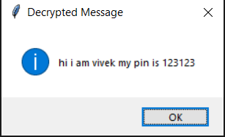

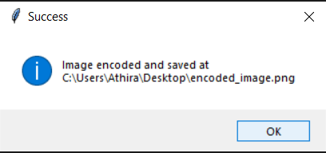
Results

Slide 8
Conclusion
This Image Steganography Tool is a secure, efficient, and user-friendly way to conceal sensitive messages within images. With password protection, automatic file saving, and an intuitive GUI, it offers a robust solution for private communication. The project showcases how steganography can be effectively used for secure, covert messaging.

Slide 9
GitHub Link
https://github.com/vivekpce/imagestego-gui.git

Slide 10
Future scope(optional)
There are several ways this tool can be expanded and improved in the future: Support for Video Steganography – Extend the concept to hide messages inside video files. Cloud Storage Integration – Securely upload and retrieve steganographic images from the cloud. AI-based Image Analysis – Implement artificial intelligence to improve security and detect tampered images. Mobile App Development – Create an Android/iOS app for secure mobile steganography. Anti-Detection Mechanisms – Improve resistance against steganalysis techniques used to detect hidden messages.

Slide 11
THANK YOU

